Slide 1
Surviving the Summer Holidays
Kate Seasman
Sleep Service Manager
Advisory Teacher

Slide 2
Supporting Yourself
Everybody needs a support network - talk to family and friends and plan ahead; have those you can call on in your hour of need, and those that can help in small ways, like picking up some shopping
Look after your own time and stress. Accept that you can’t do it all and look at ways you can give yourself regular breaks
Look at the Direct Payments schemes or charitable organisations that can be used to fund a personal assistant or a short break holiday. If eligible, families can receive a payment and organise support themselves
Some firms produce guidance for helping you with working form home during thr school holidays such as this one from an accounting firm: How to work from home with the kids during the summer holidays - AAT Comment
If stress levels do start to rise, try speaking to another parent who understands. Look online for local support groups or call the Parent-to-Parent service set up by NAS (0808 800 4106), or The SEN National Advice Service (0808 808 3555).
If your child is in receipt of free school meals, look at the The Holiday Activities and Food (HAF) programme (up to 16 4-hour sessions over summer)
Notes:
In Manchester area, the Newman Trust provide holidays and short breaks to families of children with SEND

Slide 3
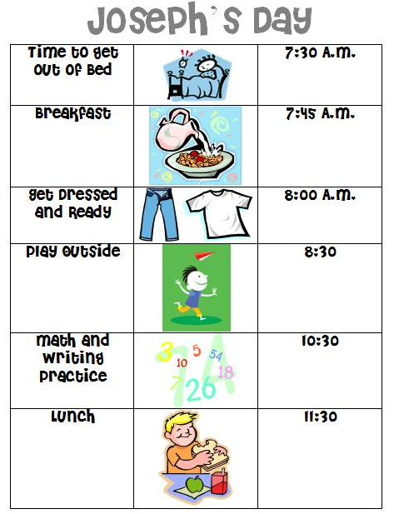
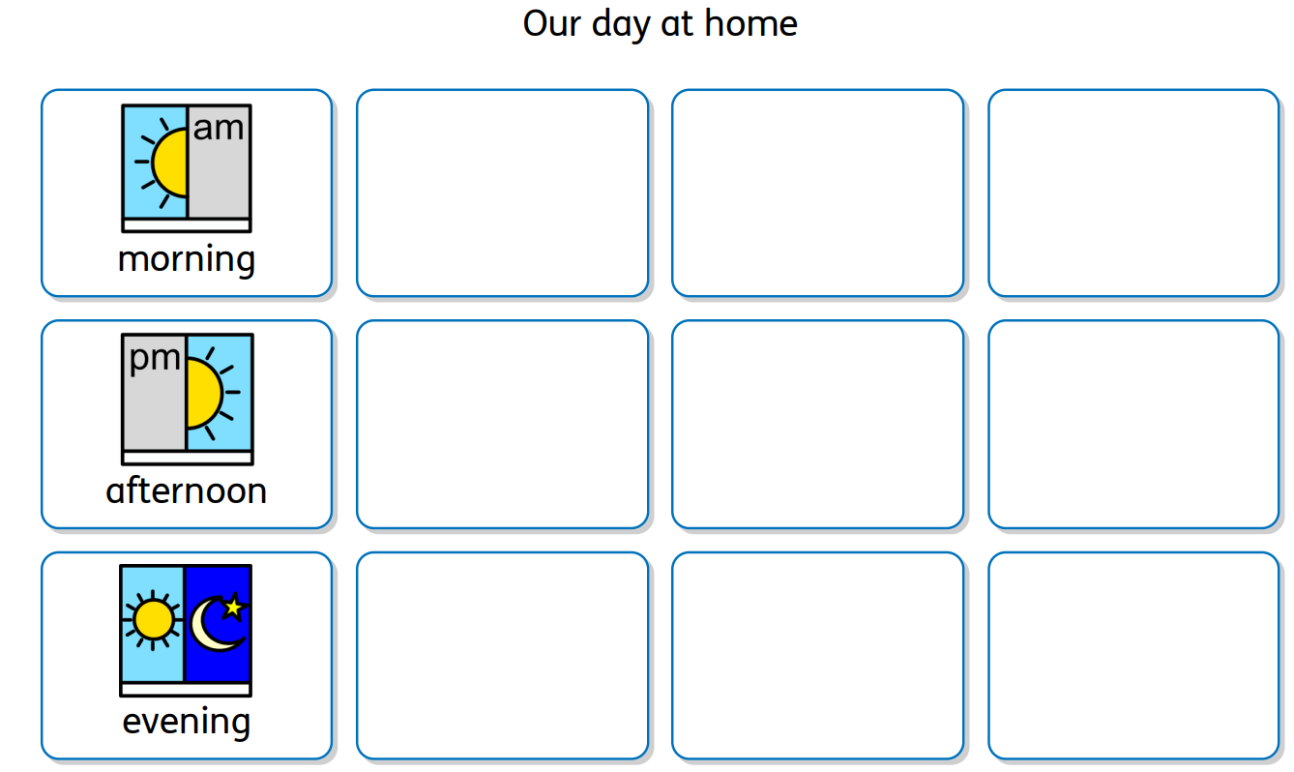
Schedule it!
Weekly planner and daily task planners. Include regular activities and set mealtimes; this will put routines in place. Include some quiet time, time alone, creative time or time spent on interests and passions. Prepare your child for any changes and stick to routines as much as possible. Colour-code your plan, highlight what is happening when.

Slide 4
Local Offer
Each local authority’s offer page will list activities that are running over the summer holidays. Type in the name of your local authority followed by ‘SEND local offer’ in a search engine to see what’s available.
Trafford
Manchester
Stockport
Trafford – under ‘short breaks’ you will find holiday clubs, youth groups and short breaks - Trafford Directory | Short Breaks
Manchester City Council – The Local Offer (Special Educational Needs and Disability) | Help & Support Manchester
They also have the SEND local offer newsletter on their website which lists what’s on over summer in addition to family events like ‘family cinema’ and ‘family coach trips’: Local Offer Newsletter | Help & Support Manchester
Stockport - Stockport SEND Local Offer | Stockport Information and Childcare Directory (fsd.org.uk)
Stockport’s local offer also lists lots of SEND-friendly leisure activities and days out in the local area: Leisure & Activities | Stockport Information and Childcare Directory (fsd.org.uk)

Slide 5
Holidays
Some parents put holidays away in the ‘too difficult to do’ box, but there are plenty of centres in the UK and abroad that are set up for children with additional needs. These centres consider the whole family; you just need to choose the one that’s right for you.
Find out about the facilities provided and whether the staff have an understanding of autism or disability in general. Think about anything specific that might make the person you are travelling with anxious, for example sensory needs. Is there a quieter area of the hotel or complex that you can book?
The Disabled Holidays website has information on holidays for autistic people and lists holiday venues in the UK and abroad.
In some cases, The Family Fund are able to provide funding for holidays away.

Slide 6
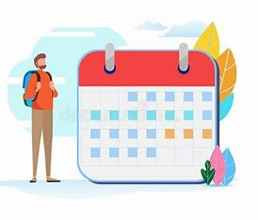
Holidays
Preparation
Spend time looking at photographs in a brochure or on the website
Compile a visual support, such as a booklet with photos, to help your child remember where they are going and what it will look like when they get there
Prepare a timetable in advance, taking into consideration any time your child will need for downtime
Think about what situations they may need to understand (such as delays or unavoidable changes to travel plans) and how you can use social stories to help them prepare
If you are travelling with a younger child, try to address any worries they may have by reading a relaxation book together or using a worry eater
Take any support materials you have prepared on holiday with you, for example you may have created a social story about going to a restaurant. Review the story in your hotel room before going down to the restaurant

Slide 7
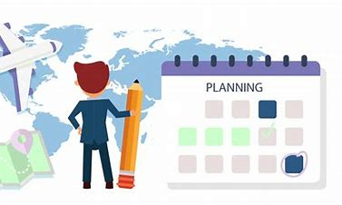
Holidays
Practical Considerations
Make your holiday provider/s aware of any special requirements needed by the person you are travelling with.
This may include:
a need to sit in a certain seat or area of your transport
any health needs, such as storage for medication
the need to wear ear defenders to block out noise
any item of comfort you may need to take with you to reduce anxiety
You may be given the opportunity to complete a form or send an email detailing these needs.
We recommend you follow up any verbal communication in writing and take a copy of this on holiday with you
“The information provided was very informative. L now gets lots more sleep and wakes up happy. Previously he was hard to wake and grumpy.”
Parent of Child L

Slide 8
Holiday
Travel
Aeroplane
Train / Boat
Download autism-friendly airport guides from the airport’s or airline’s website before travelling.
Discuss your check-in arrangements with the airline. They might be able to arrange a special check in time or have a quieter area of the airport where you can wait. You could also ask about boarding as they may let you board first or last.
Take anything that is going to make the journey more comfortable such as headphones to listen to music, ear defenders, books or toys and comforters such as pillows or blankets.
Travelling by train or boat can be a less stressful experience for some people. Again, it is important to take anything that is going to provide a distraction and make the journey easier. This could be access to favourite music, a loved book or toy.
Many train stations and ferry ports will offer special assistance for disabled travellers.
Contact the stations or port you are travelling from and to before your trip to explain that you are travelling with an autistic passenger/child with additional needs and ask what support they can offer.

Slide 9
Days Out
Planning Ahead
Many autistic people need preparing for change and this will also apply to days out Plan ahead by contacting where you are visiting to ask what support is available
Most tourist attractions accommodate visitors with additional needs in many ways
Some will publish autism-friendly guides that you can download before your visit
View the place you’re visiting beforehand on YouTube, social media and on Google Maps. Plan the visit and make a schedule for the day
When travelling there, sometimes it helps to use live navigation rather than a SatNav as time of arrival will be more accurate, automatically adjusting for traffic

Slide 10
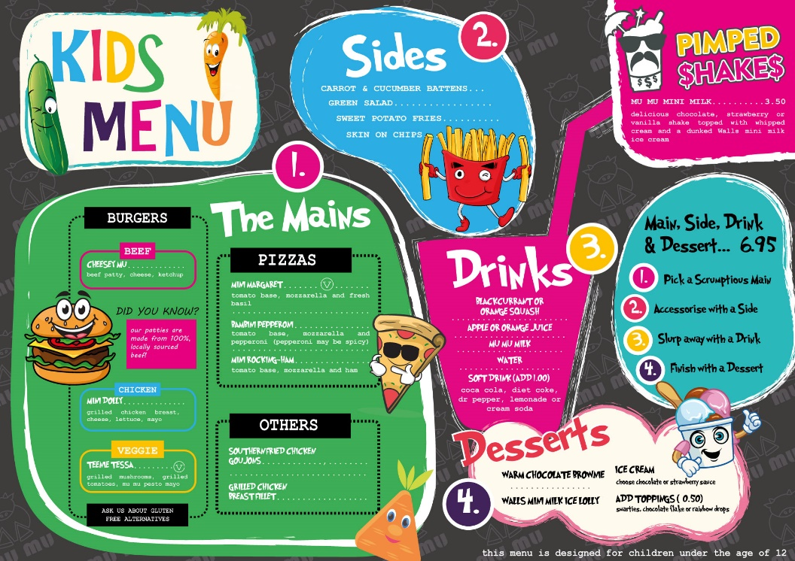
Days Out
Eating Out
If eating out can be difficult, plan ahead and book a restaurant in advance, checking dietary requirements
Google Image the restaurant so your child can see it before they go. Look it up on maps to see how long it will take to get there
Look at the menu before you go – they can be overwhelming in the moment – and decide what your child will choose When booking, ask about seating: is there a quieter area of the restaurant that you can sit in? What is the lighting and décor like? Is there anything that is likely to trigger sensory overwhelm? Some restaurants will even turn the music down for you if you ask
Take along something to keep your child busy – waiting for food can be a trigger point

Slide 11
Back to School
Preparation
Use a month-to-view calendar and mark when your child will be off and when they will be going back to school. Cross days off leading up to this. It’s really helpful to cut out September and pin it up next to August so both months can be viewed
Try to establish a regular routine a few days before, especially with bedtimes by phasing back
Drive past school when you are out and about – keep it casual
Go uniform shopping or if you’ve already done this, check they can remember how to do their tie, laces. Ask them to put pieces of uniform away to encourage them to become familiar with it again
Choose new things together so your child has control of the change, e.g. new packed lunch box, new pencils, pencil case etc.

Slide 12
Back to School
The Day Before
Have a relaxing day. Talk to your child about returning to school and any anxieties they have about doing so. Remind them that first day nerves are very normal, but that they have done this before and can do it again.
Use a daily planner to write down the morning routine and go through this the day before. Pack and prepare everything the day before school.
Talk through the school timetable for the following day (if you know it) or the school day. Share school memories. This can help to reassure some children that even though there has been a holiday, school will still be the same place it was before.
Plan a nice after-school activity for the first day back. Nothing major, small and low key, but enjoyable, works best and add this to the daily planner. It might be time on the computer or a trip to a cafe for cake.
Follow the usual school night bedtime routine, whatever that looks like in your house. Getting in routine tonight will help in the morning.

Slide 13
A

