Slide 1



Together Trust Sleep Services
May 2023

Slide 2



Who we Are and What we Do
  Together Trust is 153 years old. We exist to champion the rights, needs and ambitions of children and young people.
  We have settings covering SEN Education (Inscape House School /Ashcroft School/ Bridge College), Residential Services and Community Services.
  Our specialist sleep teams are part of a large multidisciplinary clinical service supporting services internal to the Trust, and externally across a wide range of organisations across the North West.
The sleep service supports any CYP with a sleep need and we specialise in supporting neurodivergent CYP and those with other SEND needs
5 principles services we offer:
1) Bespoke sleep clinics – full sleep assessment, sleep programme, sleep resources, follow up appointments
2) 1-2-1 sleep sessions – up to 60 minutes consultation with support notes afterwards. Hosted at events, centres or online
3) A variety of sleep workshops and training sessions for families and professionals
4) Clinical supervision sessions for staff who have received our training
5) Sleep support in schools, colleges and nurseries

Slide 3

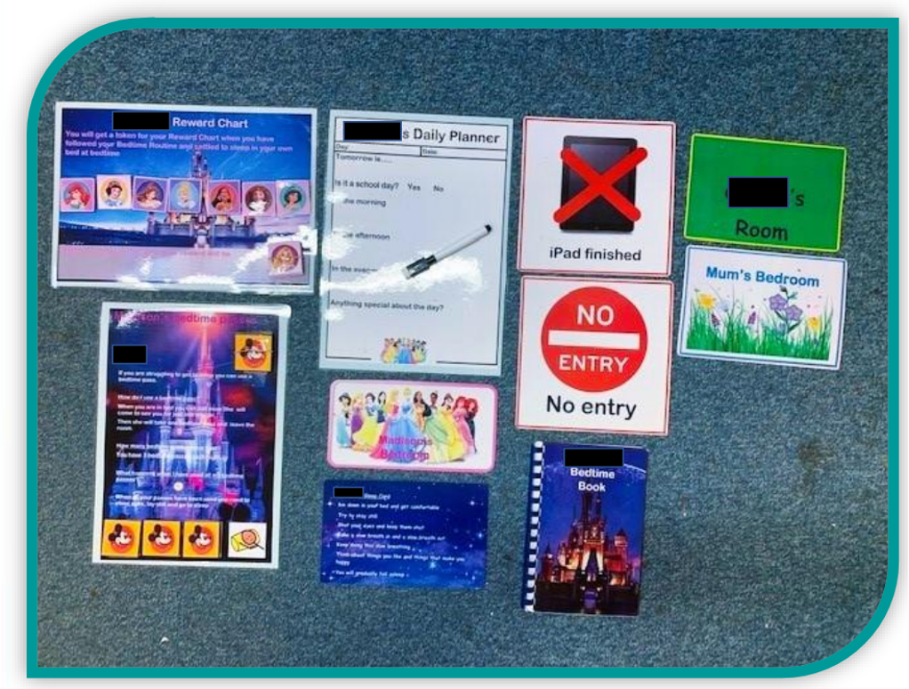
What We do – Types of resources we send to CYP
Bespoke resources made for Child M, aged 9 who loves Disney princesses.
Her personalised resources included a token reward chart to motivate her to complete her bedtime routine and bedtime passes to help her to stay in bed.
She also received a personalised book all about sleep, a daily planner to reduce bedtime worries about the next day and visual resources to help her understand when she could/could not enter other family member’s rooms at night-time.
Each family member was also given a door sign with their name on to support M to remain in her own room at bedtime.

Slide 4

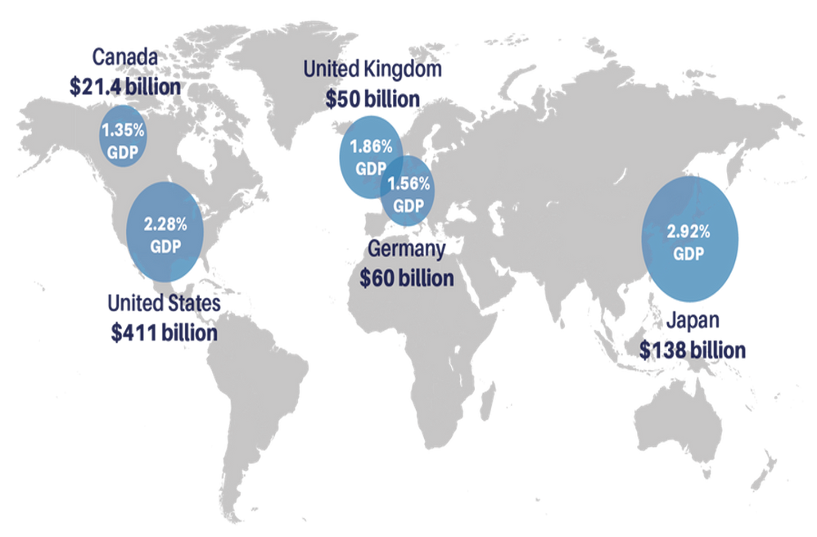
RAND Europe Research – Quantifying the Economic Costs of Insufficient Sleep
Details go here
6 hours of sleep per night or less = 13% higher mortality rate
6-7 hours of sleep per night = 7% higher mortality rate
Economic losses due to sleep in the UK = $50 billion
If individuals sleeping less than 6 hours, slept for 6-7 hours per night, there would be a $29.9 billion boost to the UK economy
The UK loses just over 200,000 working days a year because of sleep
In Rochdale alone in 2019-2020, the cost of melatonin prescriptions was over £135K, an increase on the previous two years (£93 and £99K ) . The trend was upwards again for 2020-2021.

Slide 5

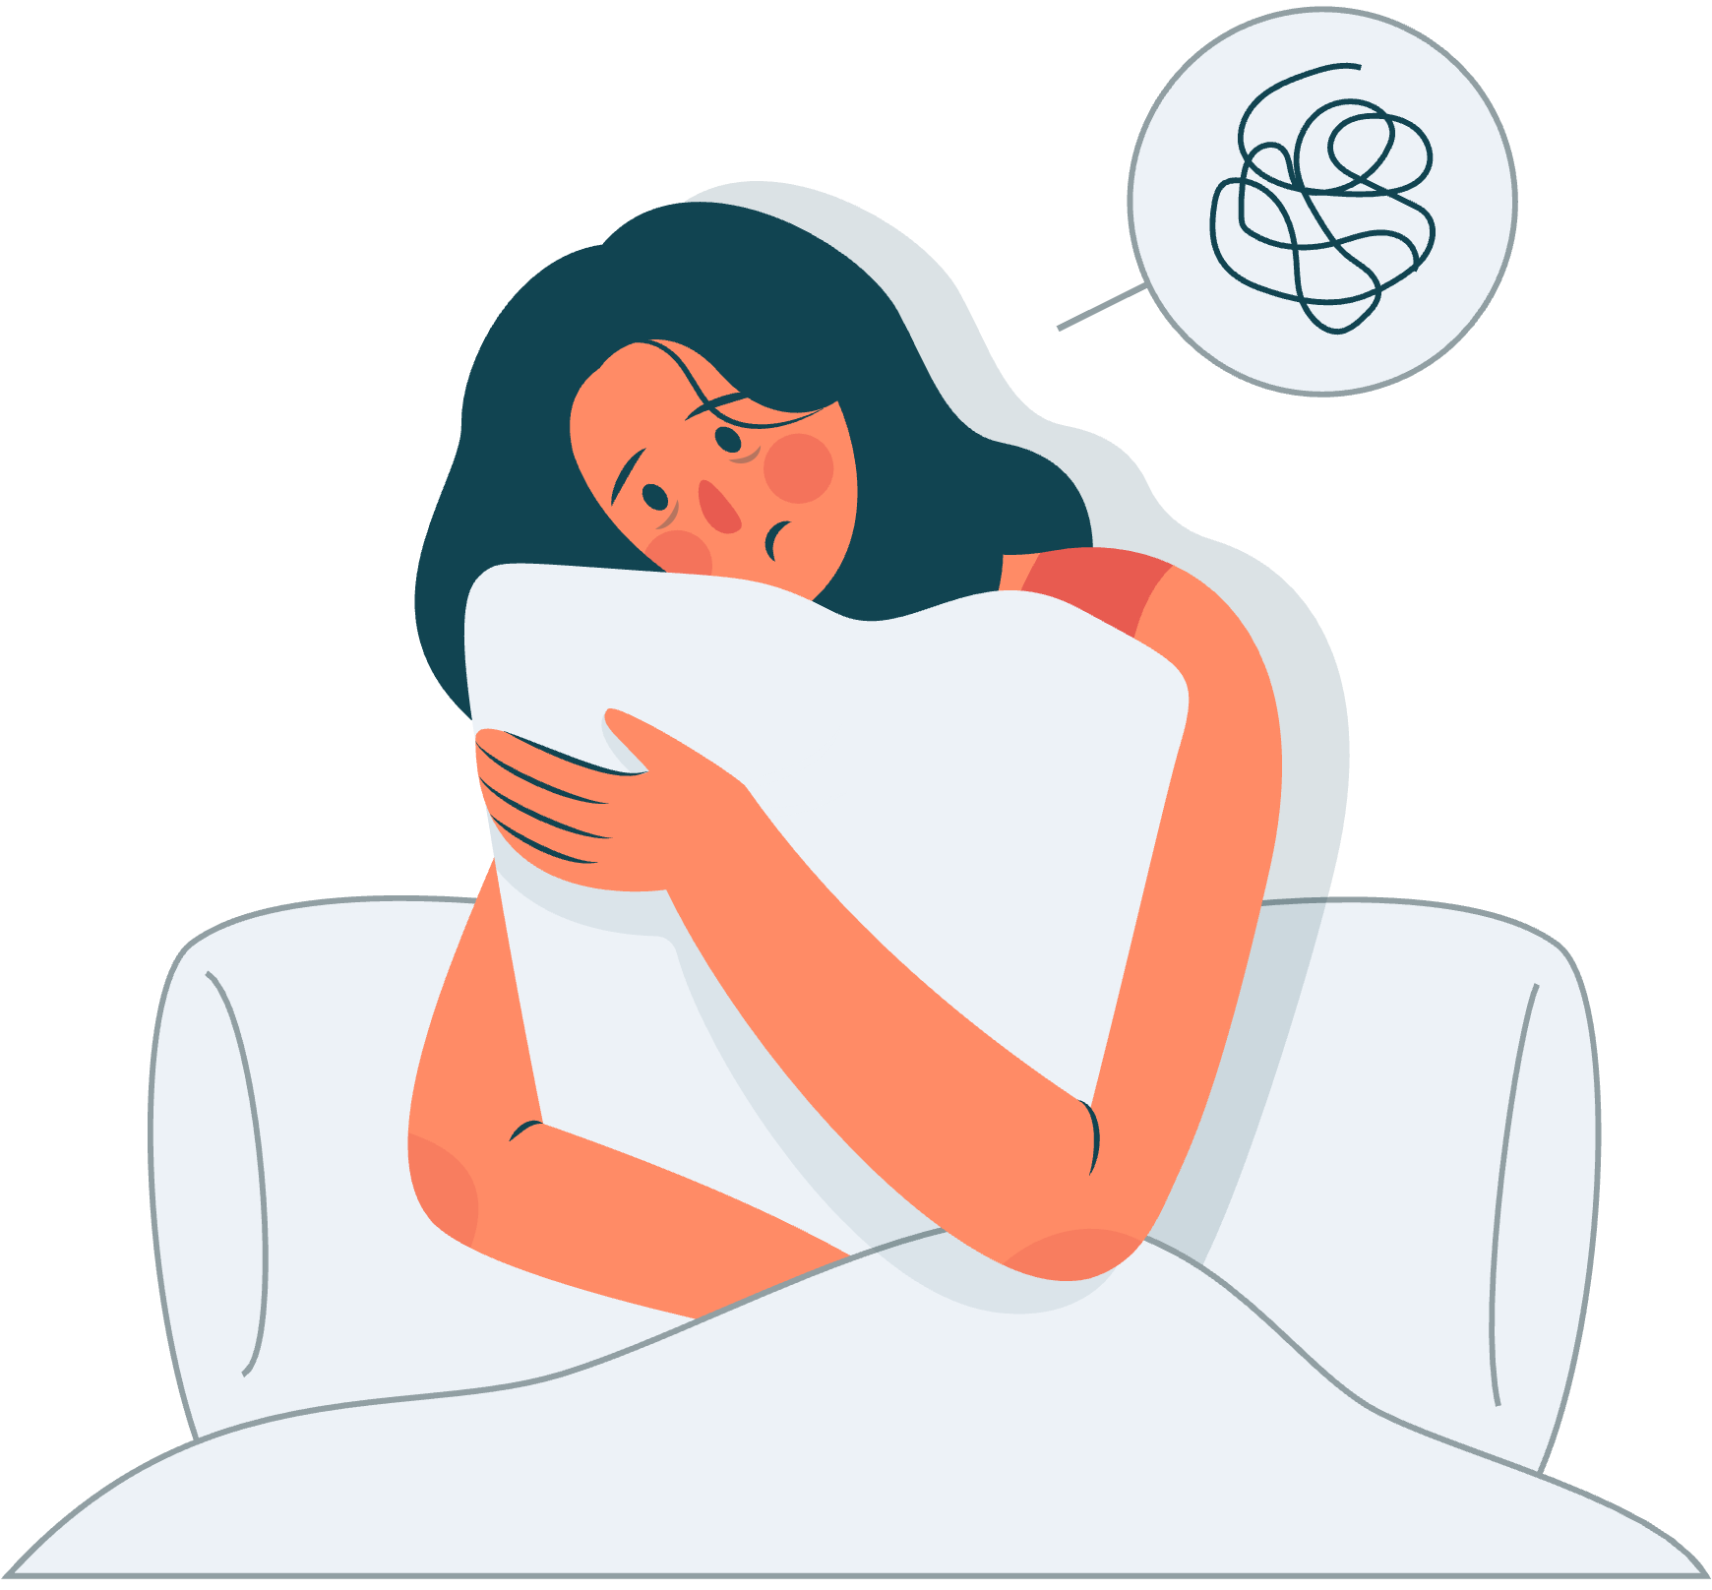
What the research is telling
us about CYP
World Health Organization's (WHO) Health and Behaviour in School-Aged Children (HBSC) 2020 Report. 3 main findings:
1) 44% of all young people surveyed reporting difficulty sleeping (although recent research has indicated it’s closer to 70% in teenagers)
2) Older children were more likely to report sleeping difficulties, with 42% of 15-year-olds admitting to not having enough sleep. This is compared to 28% of 13-year-olds and just 17% of 11-year-olds.
3) 27% of young people admitted that a lack of sleep affects their education, and that they don’t get enough sleep to be able to concentrate on schoolwork. Older girls were most at risk of this, with almost half (49%) of 15-year-old girls reporting not having enough sleep to concentrate at school.

Slide 6
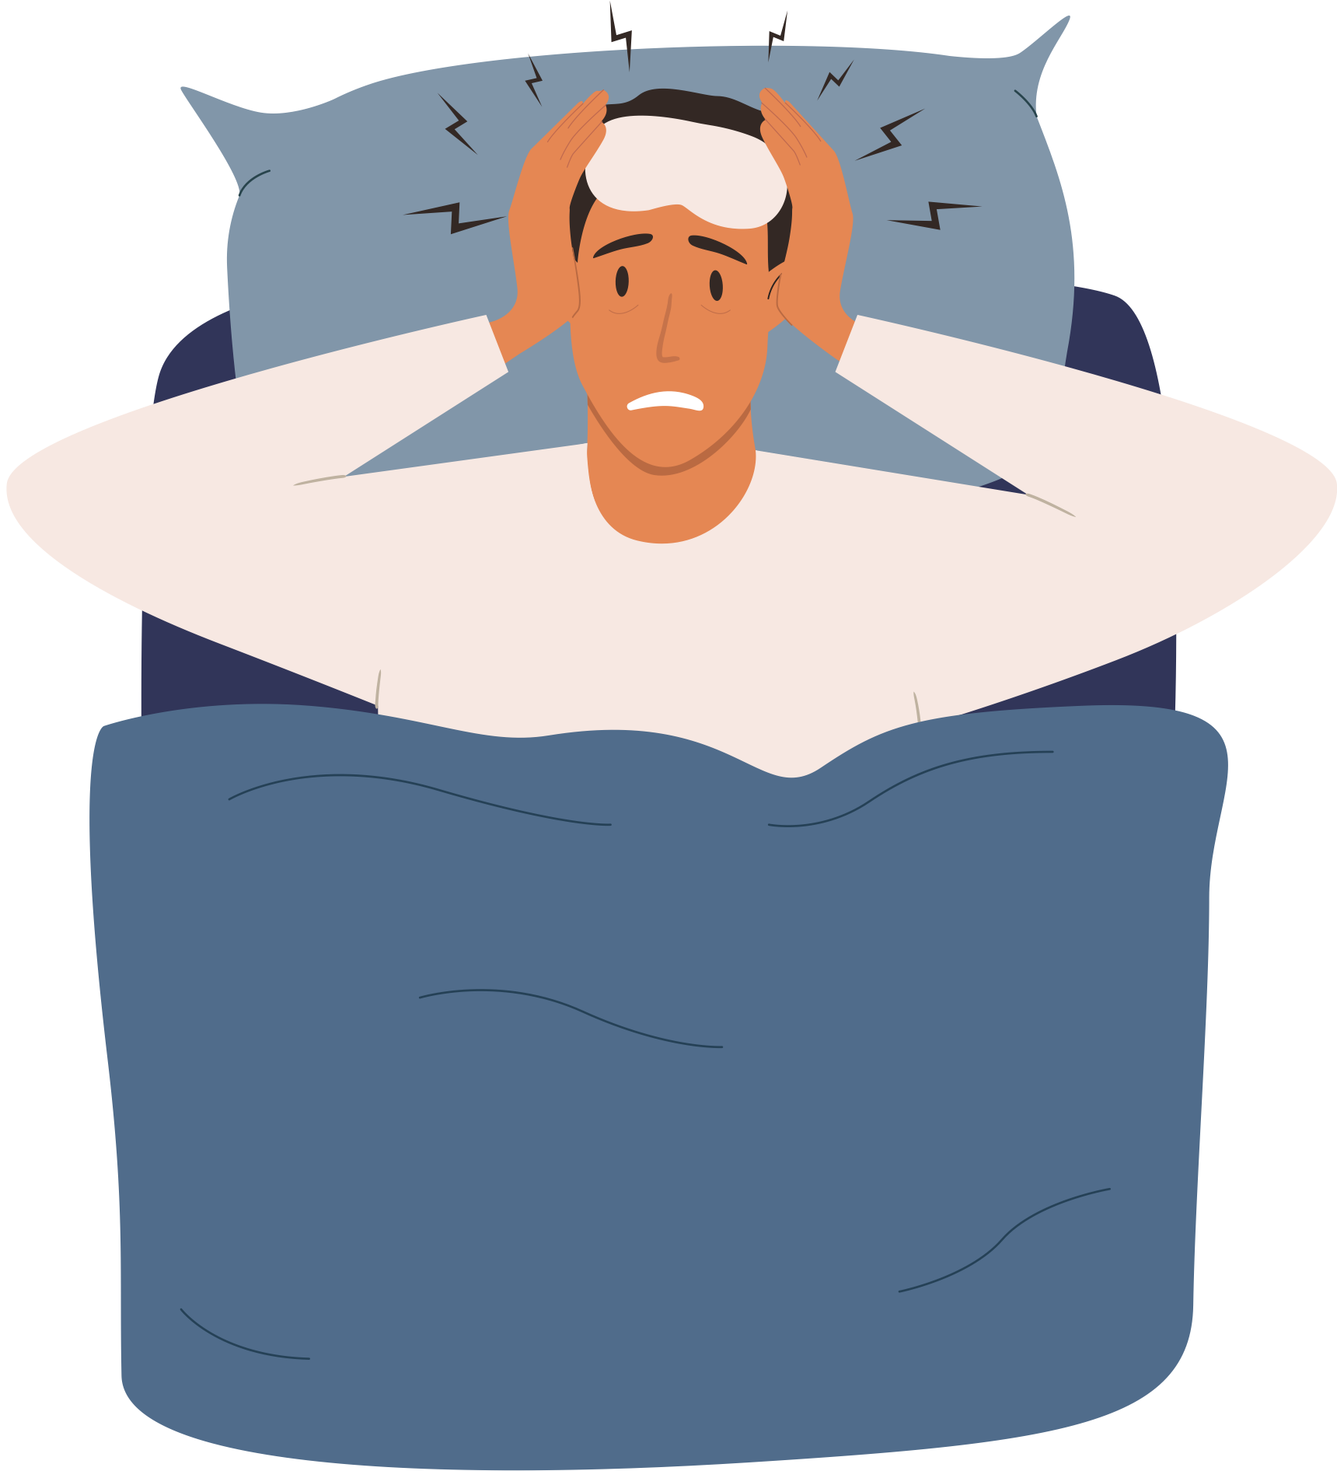
What the research is telling
us about CYP
Between 2013-2020, NHS Digital data shows the amount of under 16s being admitted as hospital inpatients for a sleep disorder doubled (6549 -> 11313)
In the Avon Longitudinal Study of over 14000 British families, following children from birth to 25, specific sleep data is being collected. Parents sleep has a direct correlation with economic performance. Mothers who gain one extra hour of sleep have a 4% increase in employment prospects, a 17% increase in their hours of work and an 11% increase in household income
Incidence of sleep disorders is significantly higher in autistic children than in typically developing children or in children with other forms of disability (40 –86%)
55% of ‘fall asleep’ crashes occur in the under 25s

Slide 7


The Wider Costs of Lack of Sleep – Health Risks
Growth, repair and immune function in CYP is affected due to delay of growth hormone release
Obesity -> sleep apnoea -> raised cortisol levels -> lower immunity and cardiovascular/skin diseases
Increased risk of certain health conditions including high blood pressure, stroke, heart attack, diabetes, cancer.
Impaired cognitive development and executive functioning – inability to sit still, focus, remain on task, retain learning, lack of recall, lower exam grades, increase in impulsivity and recklessness, decrease in logic and rational thinking, poor decision-making, increased risk of substance use (alcohol, nicotine, caffeine)
Strong link between lack of sleep and mental health – particularly anxiety and depression

Slide 8

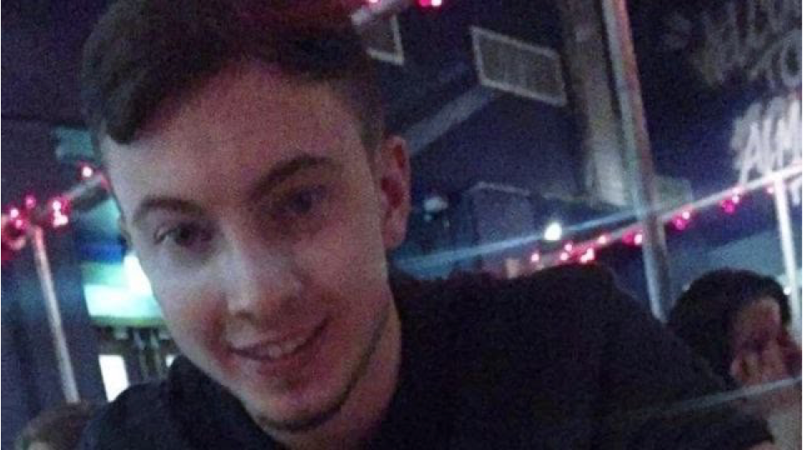
The Wider Costs of
Lack of Sleep
"He was anxious all the time.
"He said: 'I can't carry on like this, there is no way out, I just want to go to sleep and never wake up' and he was then sectioned."
David took his own life during the first night of a week's home leave.
"My mum found him on the settee in the morning," said Charlene.
"And this is because of sleep. People need to understand that sleep is a major issue."
David Marsden, 22 years old

Slide 9

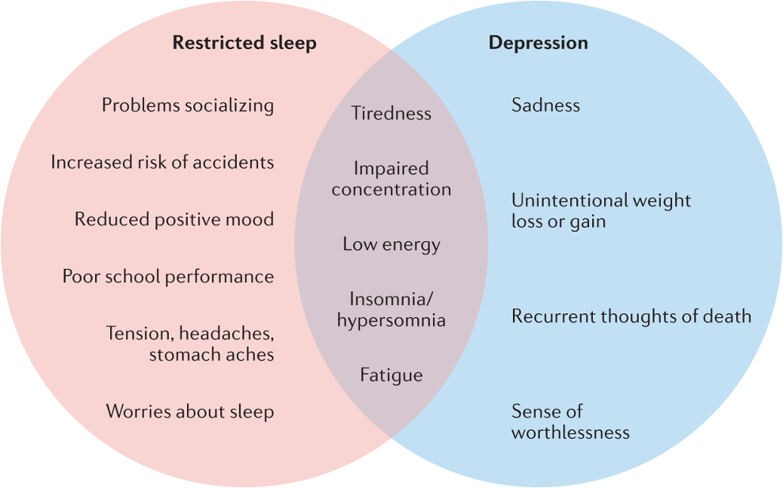
The Wider Costs of Lack of Sleep – Mental Health
In a survey of over 1600 UK adolescents, 56% reported depressive symptoms due to lack of sleep
Image:
Symptoms of restricted sleep, depression symptoms and common symptoms according to the DSM-5 (ref.32) and the International Classification of Sleep Disorders, 3rd edition (ICSD-3) (ref.81).

Slide 10









The Wider Costs of Lack of Sleep – Socio-economic
I have had to go part-time in work because I just can’t function.
My husband and I have separated.
My husband and I have rented a flat and we are taking it in turns to sleep there with our child so at least the other kids and one of us gets some sleep each night.
My daughter doesn’t go to sleep until 3am. She then sleeps ‘til mid-day and hasn’t been to school in months.
My son’s attendance is below 60% and he has always had good attendance and enjoyed school. School are on my back all the time and I have been fined.
We have bought a caravan for our drive and we are taking it in turns to sleep in there with our child.
I have given up work.
I am so drained all the time, both physically and emotionally. My blood pressure is sky high and I am on medication for that as well as depression. This all started when my youngest started struggling with sleep. It’s been like this for 2 years now.
This is having a big impact on my other children too who are all struggling getting up in the morning for school. We are all just permanently worn out. I haven’t even got the energy to sort the food shop out and we are living off freezer food. I feel like I’m losing my grip on my own kids as I haven't the energy to intervene when they’re arguing and it feels like a house of battles and permanent arguments.
Since the sleep issues started, my daughter’s anxiety levels are through the roof and she is moody and low most of the time.

Slide 11
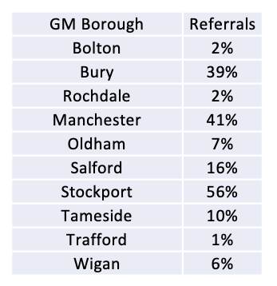
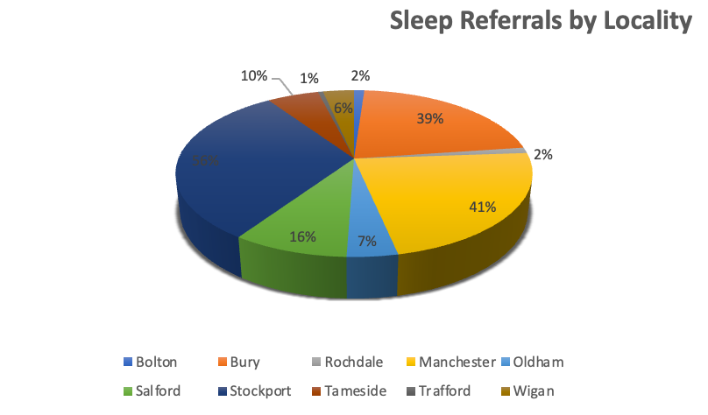
Implications for GM – Loss of Autism Sleep Clinic
Financial year 2021-2022 saw 13 children come off the autism / ADHD pathway due to behaviours symptomatic with ADHD being resolved when sleep issues are resolved. Indicative costs per child in the region of £1500 per child.
The Autism Sleep Clinic sees approximately 200 autistic CYP from GM each year and receives almost double that in referrals.

Slide 12

Implications to GM of withdrawal of the Autism Sleep Clinic – A Parent’s Voice
We have received an outpouring of concern and upset from parents when notifying them of the service closure. Some examples of feedback include:
A service and organisation that presented a holistic and tailored view of sleep issues in children, that involved the parent and empowered them to make small but significant changes.
This is what sleep-deprived parents of SEND children desperately need.
I believe the TT Autism Sleep Clinic service will be a huge loss to parents of SEND children
I have no doubt in my mind that the added value this service provided has far exceeded this amount and will have taken pressure off other mental health/health services for both parents and children.
This decision is going to leave significant gaps in the provision.
A service that makes a significant difference to our lives.

Slide 13





Action Taken by Rochdale & Trafford (2021-2022 year)
Rochdale Commission:
For CYP aged 2-18 who have social-communication difficulties
100 1:1 sleep clinic appointments with full sleep plan, resources and up to two follow up appointments
12 x 1-day professionals’ training
3 x 2-day professionals’ training
6 sets of family workshops (3 sessions each)
3 x GP twilight sessions
Free to view webinar
Attendance at bi-monthly sleep strategy meetings
Trafford Commission:
180 cases per year at sleep clinic with full sleep plan, resources and up to 3 follow up appointments. No referral criteria other than aged 2-18.
Direct priority paediatrician referral pathway – CYP must be prescribed melatonin AND have a diagnosis of autism/be on the pathway. Referrals seen within a month.
Trafford professionals have all received training in the past so we deliver 6 supervision sessions per year
6 online parent sessions (2 hours each)
Cost £102,193
Due to the training and upskilling of the workforce for one year, we have been able to reduce the cost for Rochdale to £65,766 this coming year
Cost £96,476

Slide 14

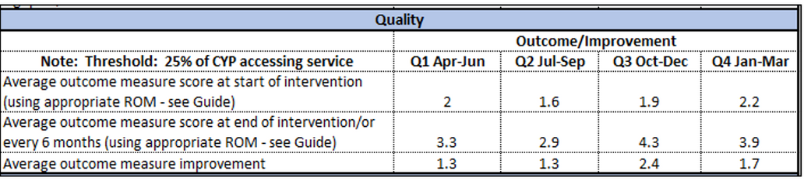
Sleep Tight Rochdale Outcomes 2021-2022
70.4% of all cases seen last year had improved sleep by discharge date.
Training Attendance
125 professionals – as an output of the training, these professionals are now confidently supporting countless young people within their local community;
  3 GPs
  18 families
  177 webinar watches
Melatonin data shows that fewer families are embarking on a medicalised journey to address sleep issues (0-4s data -51% actual reduction in spend since 2017)
There is a reduction in the rate of increase in spend across all age ranges apart from age 5-9
15-19yo -5% reduction in rate of increase in spend
10-14 -10% reduction in rate of increase in spend

Slide 15
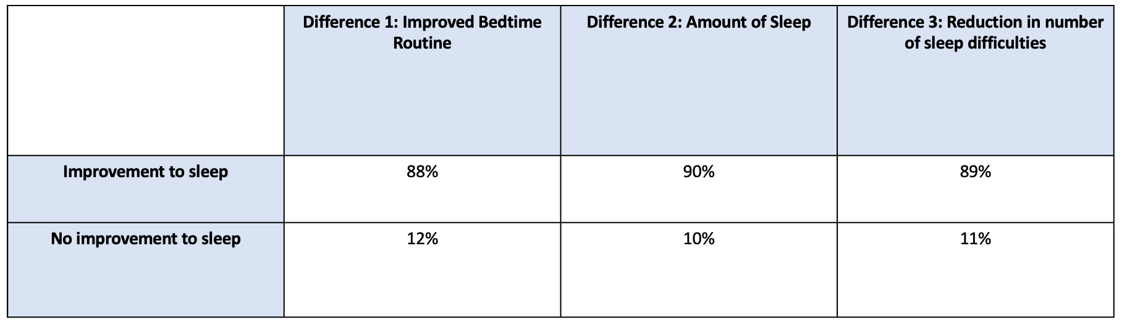
Sleep Tight Trafford Outcomes 2021-2022
218 cases seen last year

Slide 16
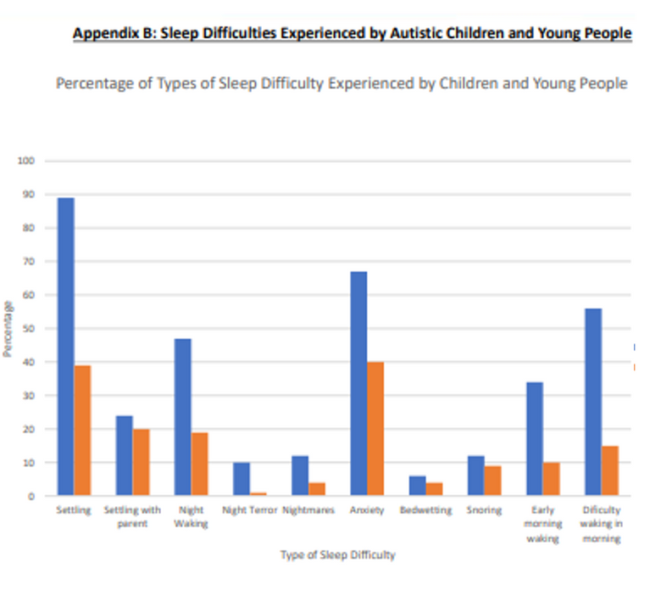
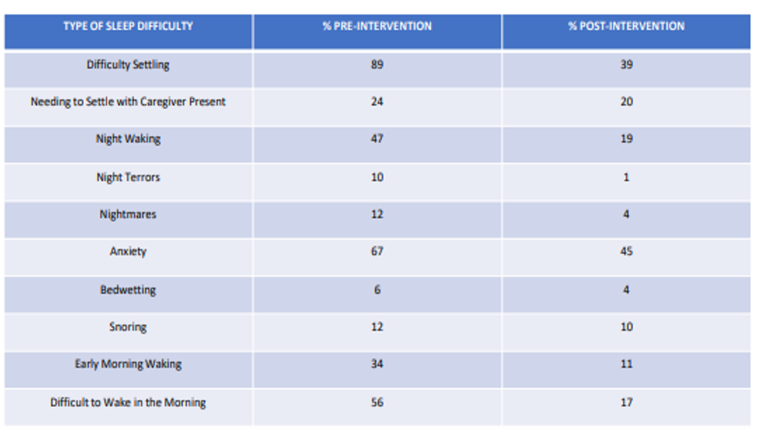
Autism Sleep Clinic
Outcomes 2021-2022
Pre-intervention
Post-intervention

Slide 17
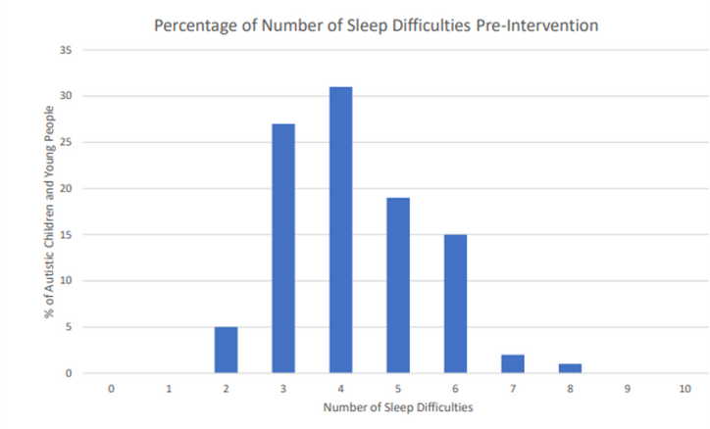
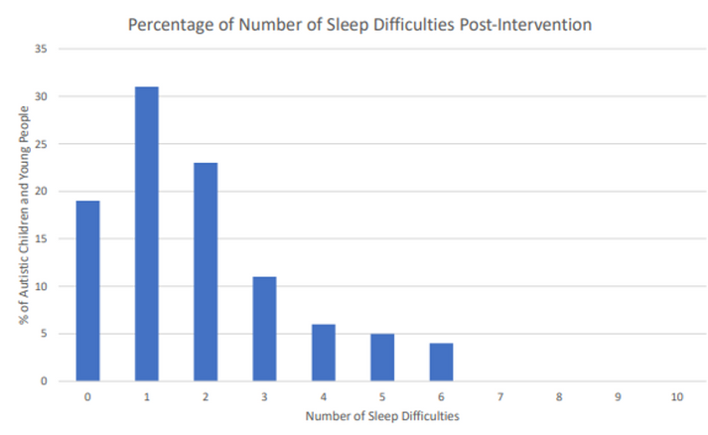
Autism Sleep Clinic Outcomes 2021-2022
Pre-intervention 58% of autistic children and young people had 3 to 4 sleep difficulties which were impacting on their sleep.
Post-intervention, this reduced to 16%.
After receiving support, there was a significant reduction in those reporting sleep difficulties.

Slide 18
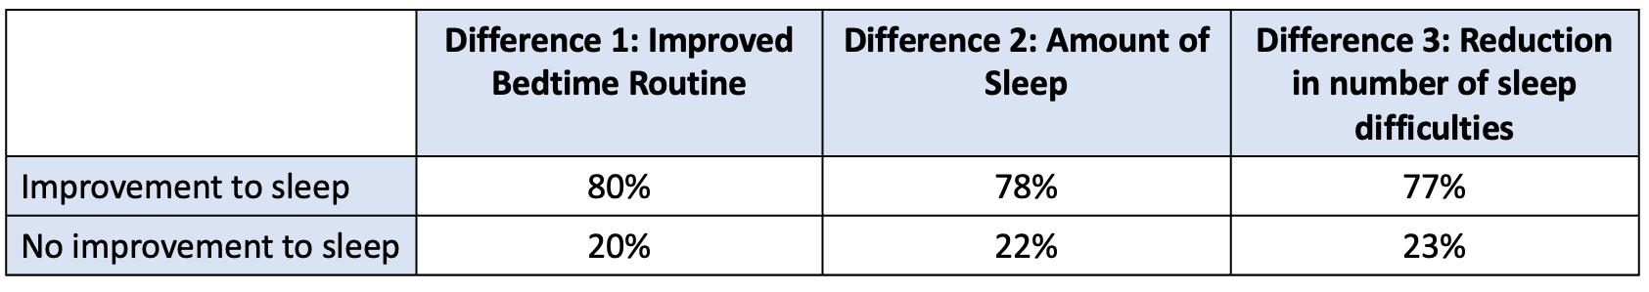
Autism Sleep Clinic Outcomes 2021-2022
Our data pre-intervention also showed that 95% of autistic young people had a bedtime routine that lasted longer than an hour, which dropped to 40% after intervention.
Prior to intervention, 77% of the bedtime routines were taking 3 hours or more, which dropped to 24% after intervention.

Slide 19
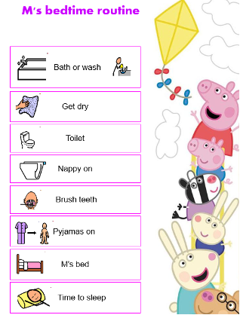
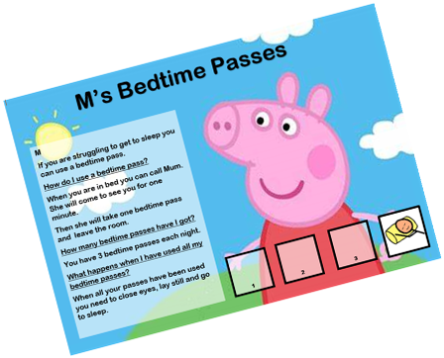
Impact of specialist 1:1 Sleep Clinics – A Case study
MG – 3 year old girl on the waiting list to see a paediatrician regarding behaviours symptomatic of ADHD
Hadn’t slept well from birth, taking several hours to settle, sleeping for an hour and then waking and screaming. This could last for 3 or more hours, disturbing her 3 siblings and parents. She would settle again for an hour or two and the screaming would begin again. Mum had stopped working.
Parents received tailor-made sleep hygiene advice and steps to take and resources based on MG’s interest (Peppa Pig). At this stage, parents were rating MG’s sleep at 1 on a scale of 1-5.
4 weeks later - MG began to settle more quickly at bedtime but still woke in the night. Follow-up advice ensued.
2 weeks later - MG was sleeping from 9 pm until 5 am - 9 hours of sleep. This progressed to sleeping from 8 pm to 7 am (11 hours of sleep in the normative range for age).
Parents rated MG’s sleep at 5 at the end of treatment and said, “Everyone has benefitted, we have more family time and much more energy. I [mum] have been able to return to work part-time which has helped our finances massively.”
MG was taken off the pathway as her behaviours improved so significantly and were no longer a concern

Slide 20
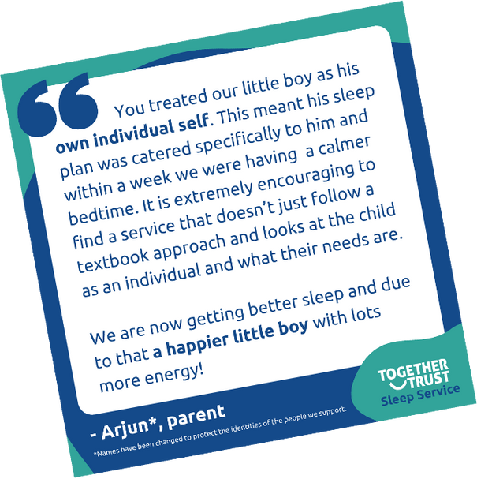
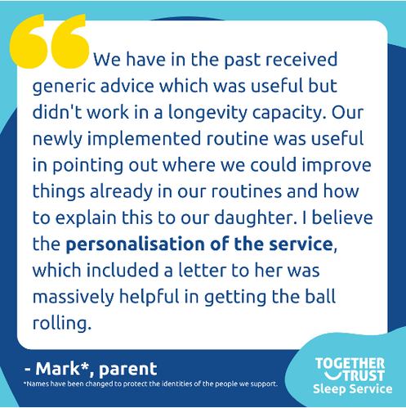
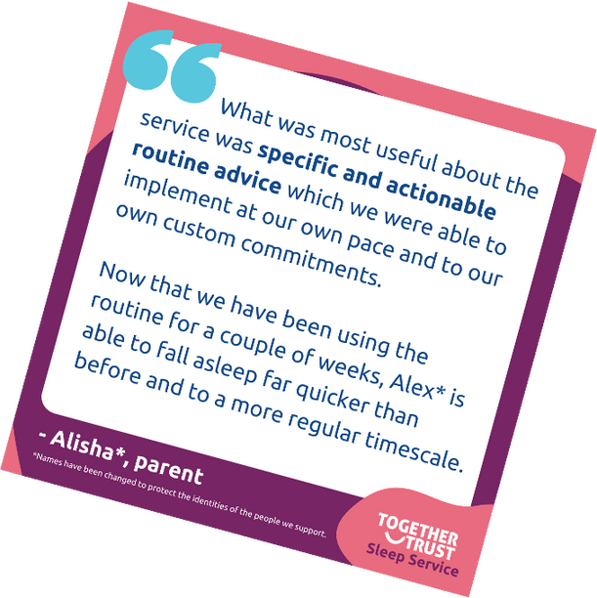
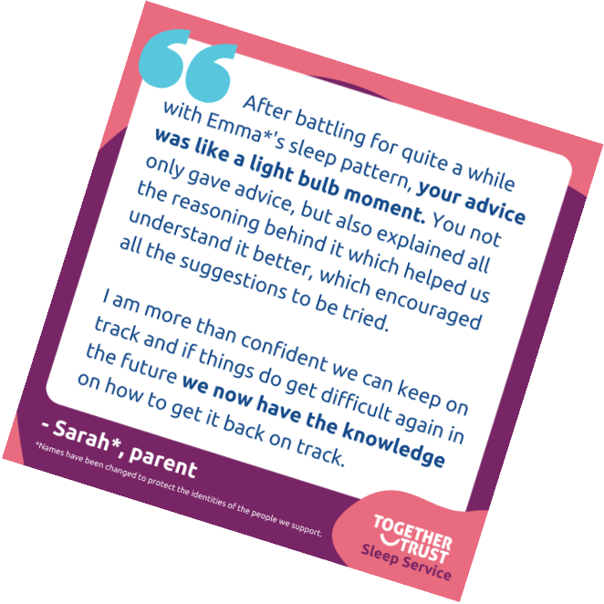
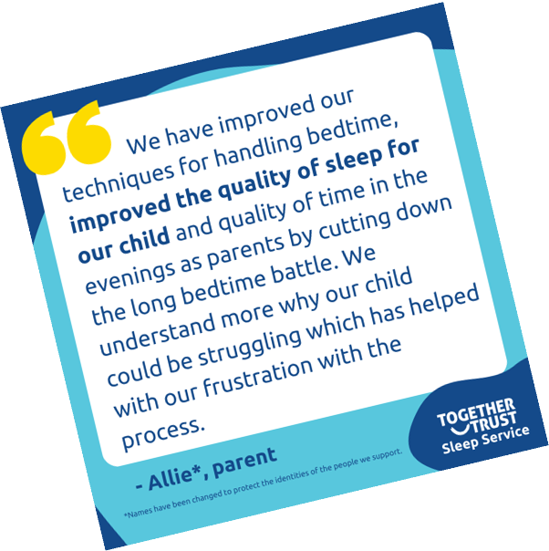
What our families say

Slide 21
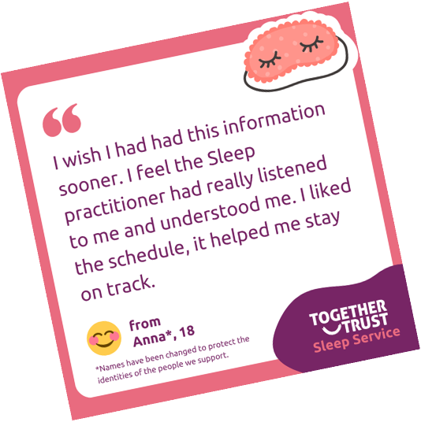
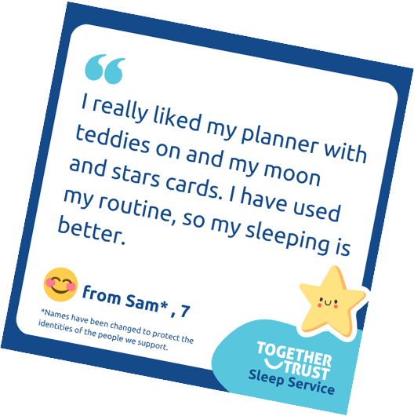
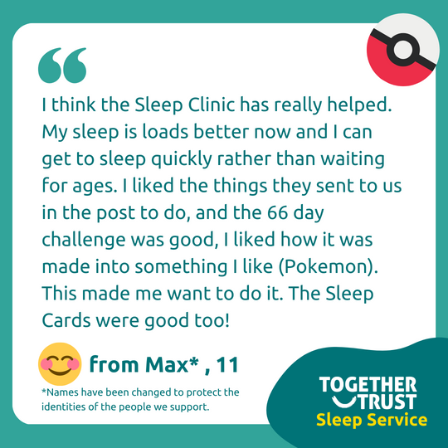
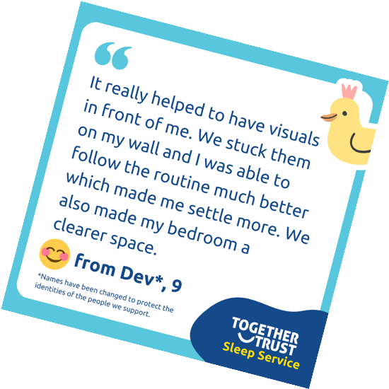
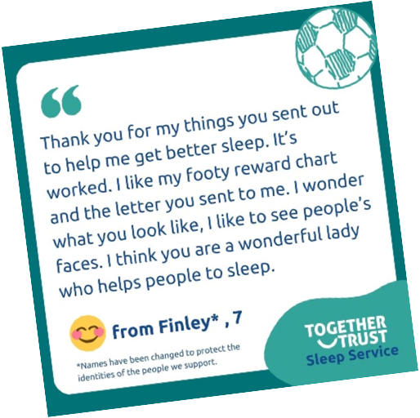
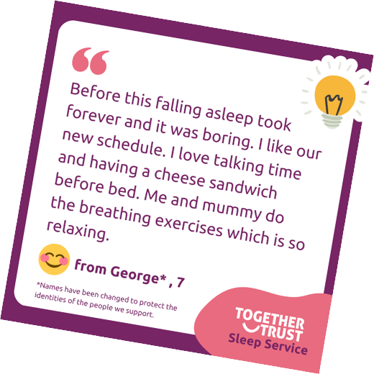
What our young people say

Slide 22
Contact details
Kate Seasman, Sleep Service Manager
Kate.Seasman@togethertrust.org.uk
Rick Vogan, Head of Clinical Services
Rick.Vogan@togethertrust.org.uk

